Slide 1
Employee Data Analysis using Excel
STUDENT NAME:S.Jyothika
REGISTER NO:312219050
DEPARTMENT:3rd Year
COLLEGE: aksheyaa College of arts and science

Slide 2
PROJECT TITLE
Employee Performance Analysis using Excel

Slide 3


AGENDA
Problem Statement
Project Overview
End Users
Our Solution and Proposition
Dataset Description
Modelling Approach
Results and Discussion
Conclusion
3/21/2024 Annual Review

Slide 4

Here are some potential problem statements for employee salary analysis

Slide 5

PROJECT OVERVIEW
salary information, bonuses, commissions, benefits, performance metrics, employee demographics, and market benchmarks

Slide 6

WHO ARE THE END USERS?
The end users of employee salary analytics include HR professionals, employees, and compensation professionals

Slide 7

OUR SOLUTION AND ITS VALUE PROPOSITION
An empoyee value proposition (EVP) is a statement that outlines the value employees perceive they gain from working for an organization

Slide 8
Dataset Description
Employee Details dataset contains information such as employee ID, name, position, salary, and attendance. This information can be used to gain insights into the company's workforce, their performance, and overall productivity.

Slide 9

THE "WOW" IN OUR SOLUTION
There are three types of payment that have traditionally been very popular with employers. These payment methods are cash, check and direct deposit. Direct deposit is generally considered to be the most widely used payment option.
3/21/2024 Annual Review
9

Slide 10
MODELLING
Modelling Analyst salary in India ranges between ₹ 6.0 Lakhs to ₹ 19.1 Lakhs with an average annual salary of ₹ 9.0 Lakhs. Salary estimates are based on 67 latest salaries received from Modelling Analysts. 0 - 3 years exp.
10

Slide 11
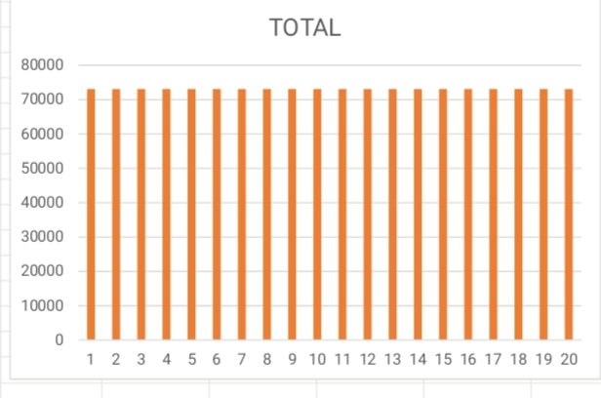
RESULTS
11

Slide 12
conclusion
Finally, the benefits that a sophisticated HR information system brings can not be overemphasized. An effective, reliable, and safe system ensures convenient administration of the personnel's daily records and, hence, has a major contribution towards the organization's prosperity

